Slide 1
Implementation and scale-up of Rapid Test Continuous Quality Improvement Brazilian Experience Alisson Bigolin Head of the Diagnostics Division, Ministry of Health, Brazil

Slide 2
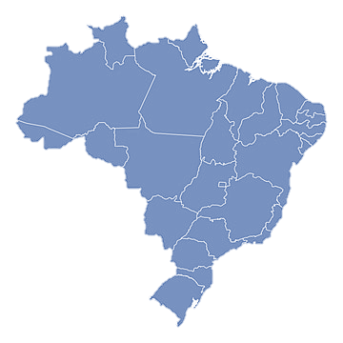
Background
Universal health coverage and comprehensive care
HIV:
Prevention methods;
Rapid diagnostics, Viral Load, CD4+ count, genotyping tests;
ARTs
27 Federation Units
Federal
5,570 municipalities
136 sites that perform HIV viral load
125 sites that perform CD4+ count

Slide 3
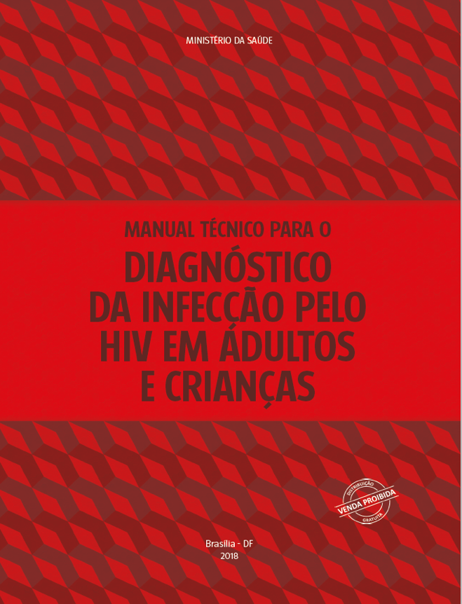
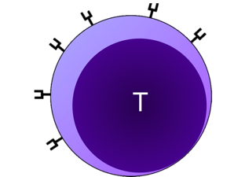
HIV infection diagnosis guidelines
Anti-HIV Rapid Test
(RDT1)
Anti-HIV Rapid Test
(RDT2)
Immediate blood collection for VL and CD4
Positive
Positive
HIV positive sample
TDF+3TC+DTG
Immediate start or within a maximum of 7 days of ART
Diagnostic complementation
Establishing baseline viral load for monitoring
Assessment of immune system impairment
Viral Load
(T2)
Assess the need for prophylaxis for OI
Immunoassay
(T1)
Immediate blood collection for CD4
Positive
≥ 5000 copies/mL*
HIV positive sample
*Under review in updating guidelines

Slide 4
Definition of a logistics system for rapid POC tests
HIV Rapid POCT since
2012
MoH
27 States
Population: 203,0 million
5,570 Municipalities
48,161
Primary HC facilities
+
HIV/STI services
INFORMATION ON CONSUMPTION AND NEED FOR RESUPPLY
*Fonte: Avaliação Externa do Programa Nacional de Melhoria do Acesso e Qualidade da Atenção Básica
PMAQ 1º Ciclo (2011/2012) e 2 º Ciclo (2013/2014) comparativo das Equipes de Saúde da Família

Slide 5
Number of rapid HIV tests distributed in the country by the Ministry of Health
Fonte: Caderno de Informações Logísticas
*Dados até jun/2024

Slide 6
Percentage of coverage of rapid HIV tests among the 5,570 municipalities in Brazil
Tests available
No tests
95% of Brazilian municipalities have rapid tests available for HIV
Fonte dos dados: SIA/SUS, SISLOGLAB, SISAB, PMAQ
Slide: BIGOLIN, 2021

Slide 7
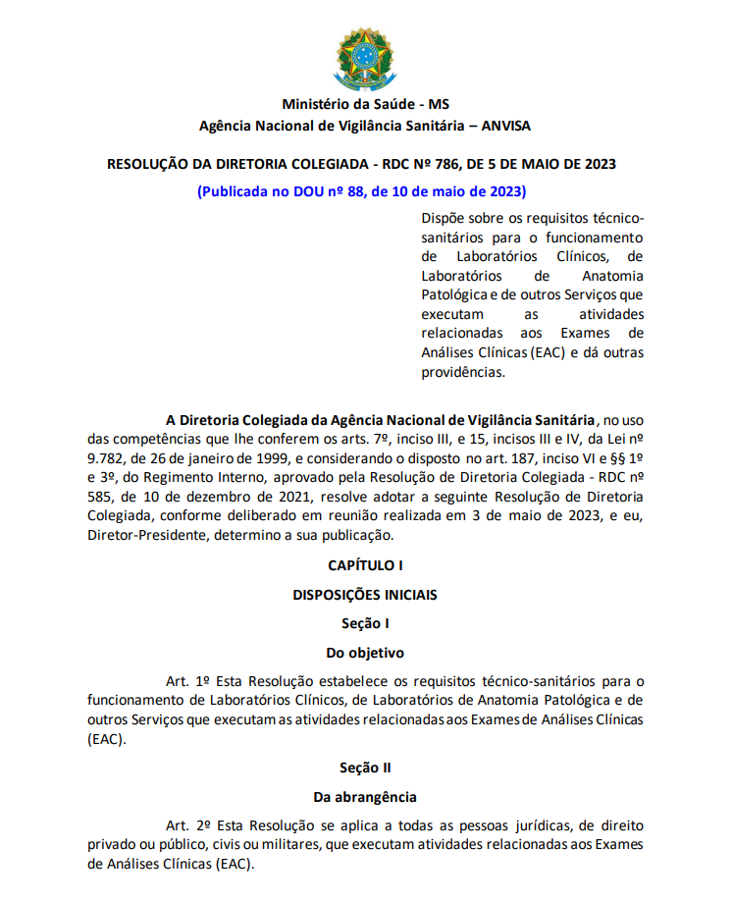
Legislation to Clinical Analysis Tests
National Health Surveillance Agency (ANVISA) Legislation
Provides for the technical and sanitary requirements for the operation of Clinical Laboratories, Pathological Anatomy Laboratories and other Services that perform activities related to Clinical Analysis Tests.
Content:
Classification of health services;
Necessary infrastructure;
Quality Assurance Program;
Technology management;
In vitro diagnostic products, reagents and supplies;
Information system;
Inherent risk management;
Waste management;
Document management;
Personnel management and ongoing education of professionals;
Traceability of biological material;
Transportation of biological material;
Pre-analytical phase, Analytical phase and Post-analytical phase
There are teams in all municipalities to monitor compliance with this legislation.

Slide 8
Rapid Test - Quality Assurance
Brazilian MoH manages five quality tools for Rapid POCT in public healthcare system
Customer Service (CS) registers for Rapid POCT reactive post-marketing evaluation
Technical criteria definition for Rapid POCT acquisition
Adherence to distance Rapid POCT training provided by MoH
Participation in Rapid POCT External Quality Assessment (EQA) program
Performance criteria verification results for lots acquired

Slide 9
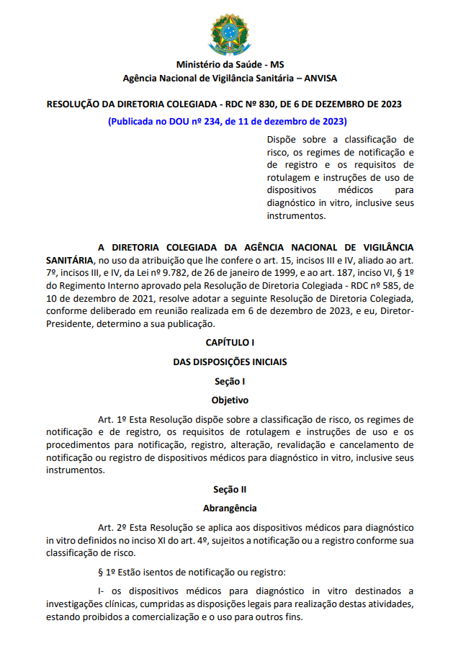
Rapid POCT acquisition
Must be registered with the National Health Surveillance Agency (ANVISA)
Criteria provided for by law:
Performance study dossier;
Packaging specifications;
Product evaluation by INCQS
The rapid HIV test to be provided must have at least:
Sensitivity | Specitivity
99,5% | 99,0%
Product demonstration analysis: technical and practical evaluation of the product, following the procurement requirements. Only tests approved at this stage may be provided to the MoH.

Slide 10
Rapid POCT acquisition
Supplier obligations:
Provide a video and manual with the methodological principle of the test and detailed instructions on how to perform the test.
Provide a telephone line and email address for users to access assistance.
Send monthly records of customer service to the Ministry of Health.
Technical visits to some health facilities when difficulties are identified.

Slide 11
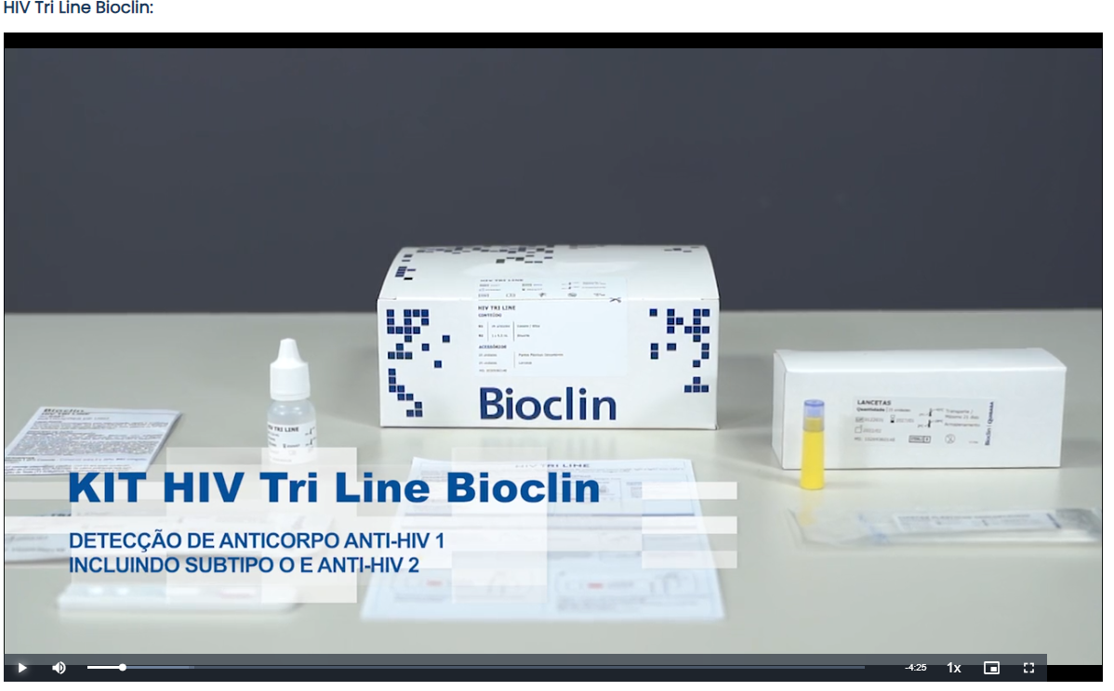
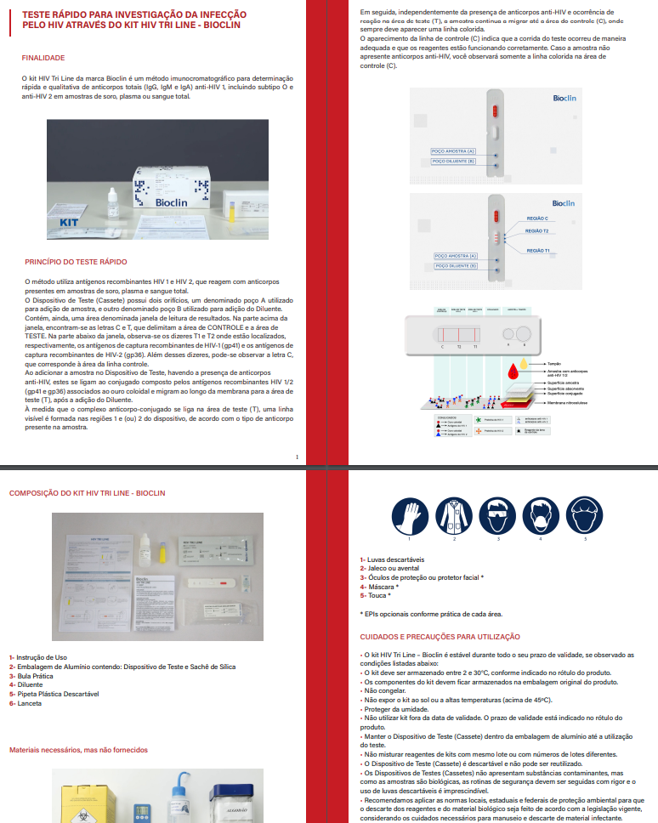
POCT training
Videos
Distance POCT training provided by MoH
Cover
Course Presentation
Module 1 - Practical Guide for Performing Rapid Tests for HIV Infection, Syphilis, Hepatitis B and C
Module 2 - Rapid Tests for HIV Infection
Module 3 - Rapid Tests for Syphilis
Module 4 - Rapid Tests for HBV Infection
Module 5 - Rapid Tests for HCV Infection
Module 6 - Rapid Tests for Simultaneous Detection of Anti-HIV-1/2 Antibodies and Treponemal Antibodies (RT Duo HIV/Syphilis)
Assessment
Complementary guides
https://campusvirtual.fiocruz.br/gestordecursos/hotsite/utrdiag

Slide 12
POCT training
Guide on how to organize a training
How to organize training content and timing
How to register the professionals trained

Slide 13
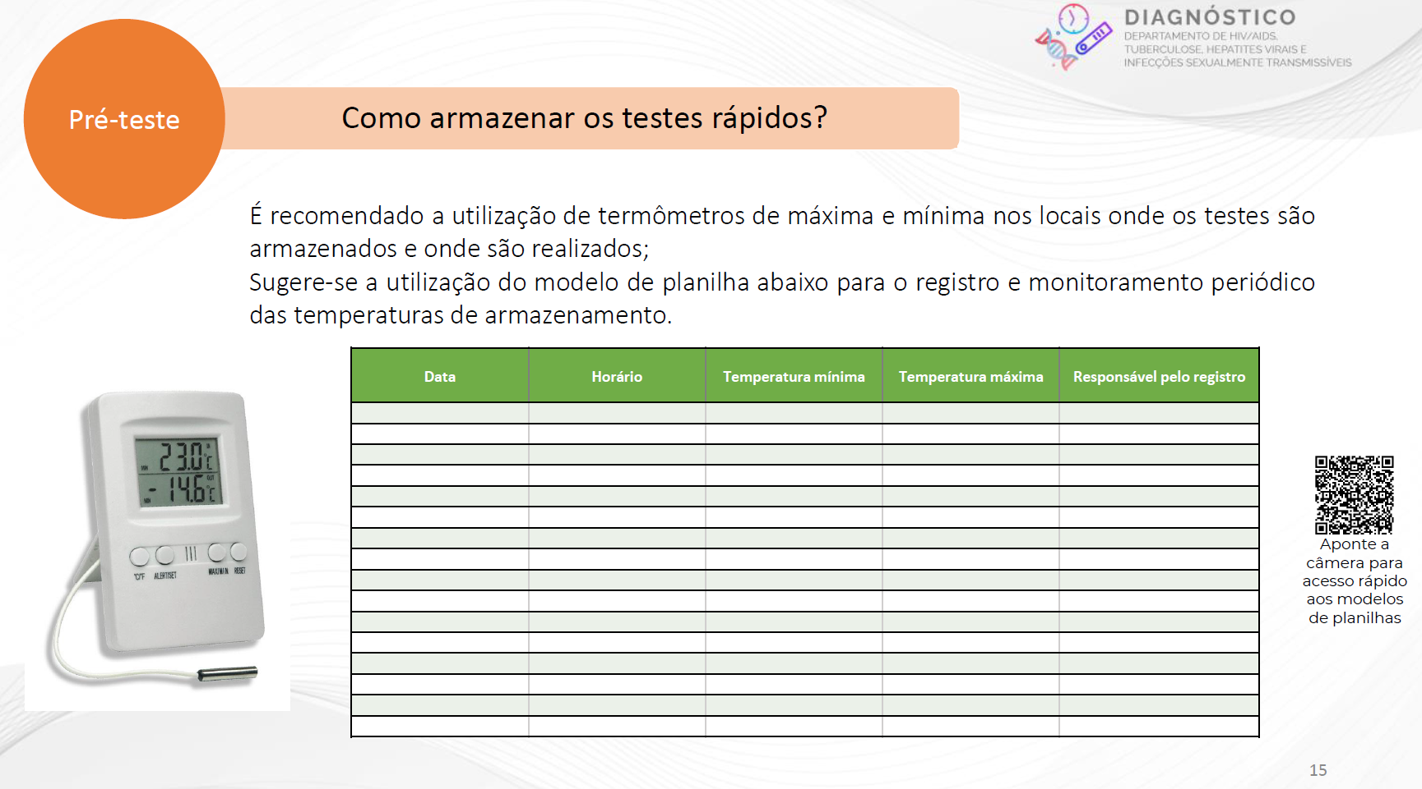
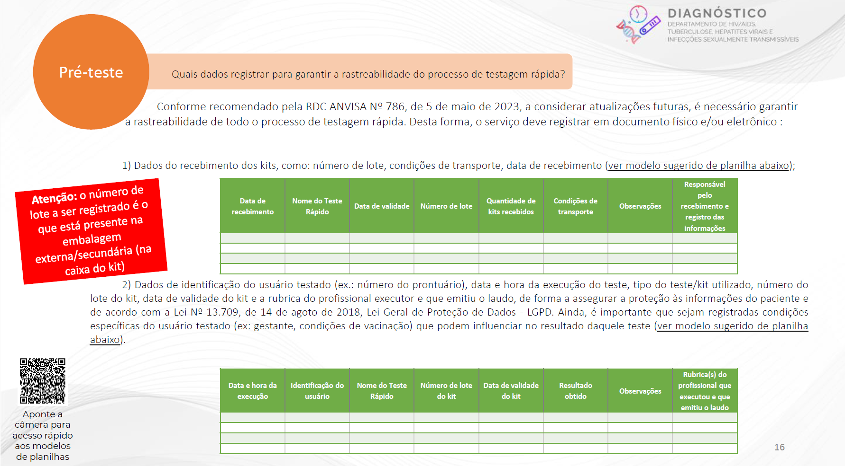
POCT training
Guide on how to perform rapid tests for HIV, syphilis, hepatitis B and C
Three sections:
Before the test,
Testing,
After the test
The QR codes direct to spreadsheet templates.
Information on test storage and recording of storage conditions
Information on recording the procedure and results of tests for traceability of the testing process

Slide 14
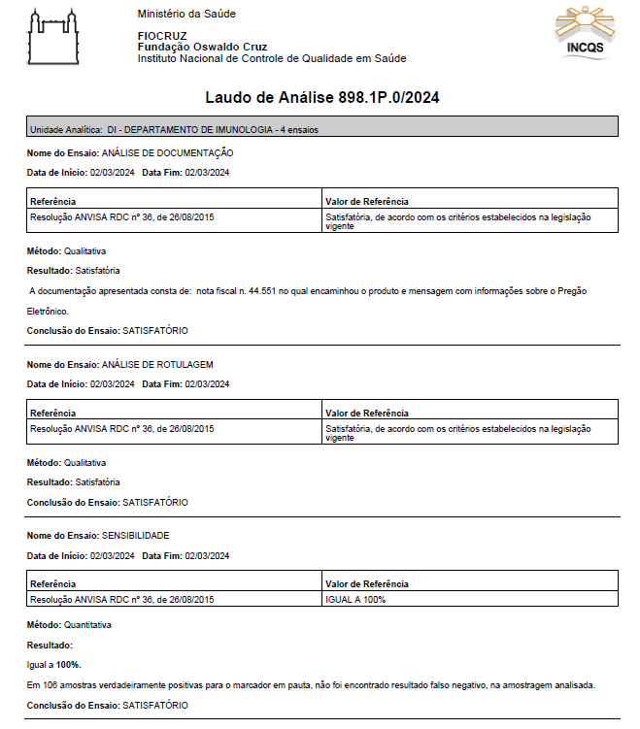
Performance criteria verification for acquired lots of POCT
Report
Documentation analysis
Production
Import
National Institute of Quality Control in Health
Label analysis
Lot analysis
Sensibility adn Specificity
Delivery to the warehouse
Distribution

Slide 15
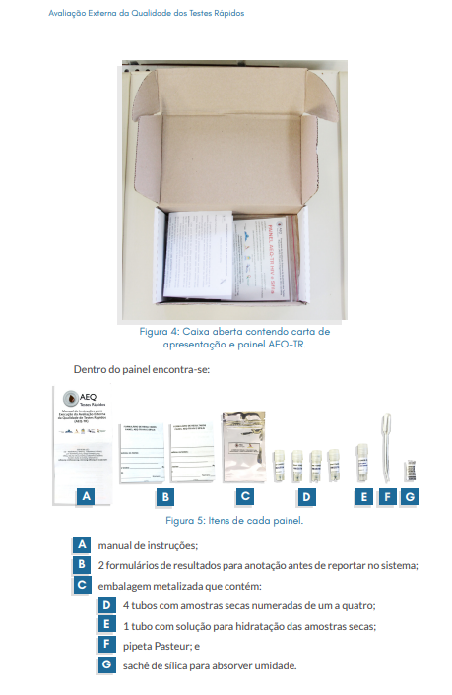
External Quality Assessment (EQA) program
External Quality Assessment - EQA (since 1997):
HIV, HBV, HCV Viral Load;
CD4+ test;
CT/NG test.
EQA for RDT(since 2012):
HIV, syphilis and HCV
Laboratory of Molecular Biology, Microbiology and Serology
Allows the territory and health service coordinators to monitor the quality of rapid testing and promote corrective actions.
This is a performance assessment in the execution of the RDT and is educational, non-punitive, free of charge and with certification after each round.
Site: https://qualitr.paginas.ufsc.br

Slide 16
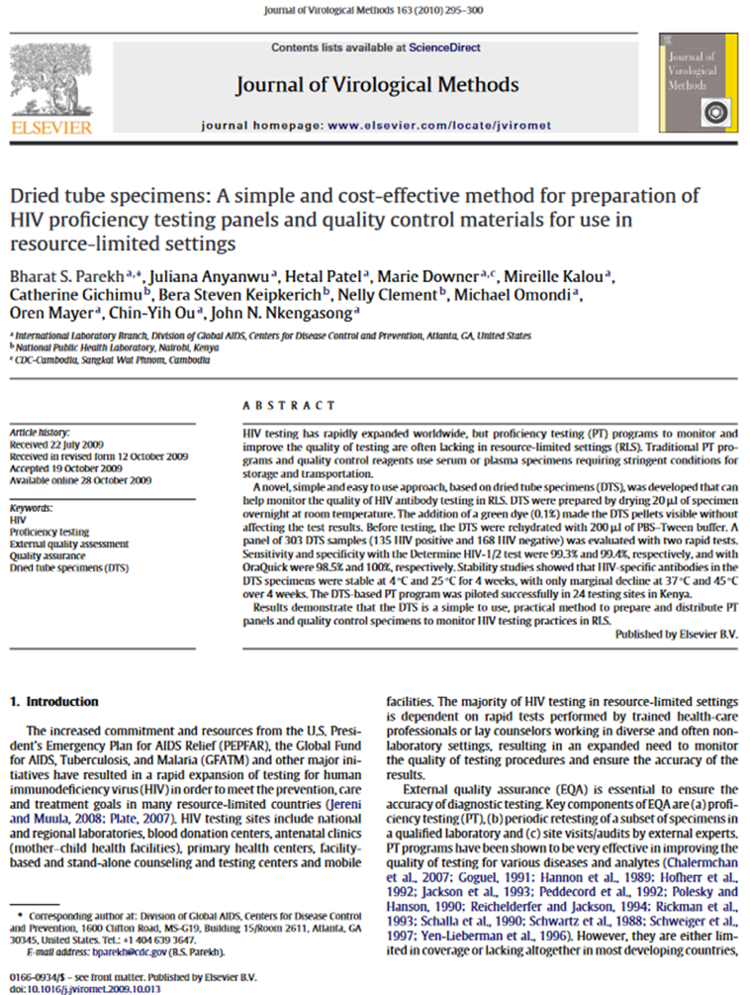
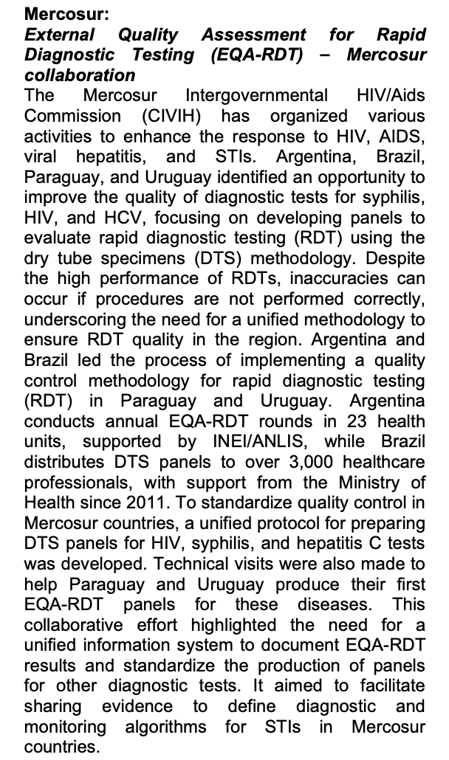
External Quality Assessment (EQA) program
It was possible to establish a unique protocol, considering the differences in reagents and instruments available in each country.
Protocol implementation training
https://www.gov.br/aids/pt-br/assuntos/noticias/2023/novembro/brasil-realiza-acoes-para-fortalecer-resposta-a-hiv-aids-hepatites-virais-e-outras-infeccoes-sexualmente-transmissiveis

Slide 17
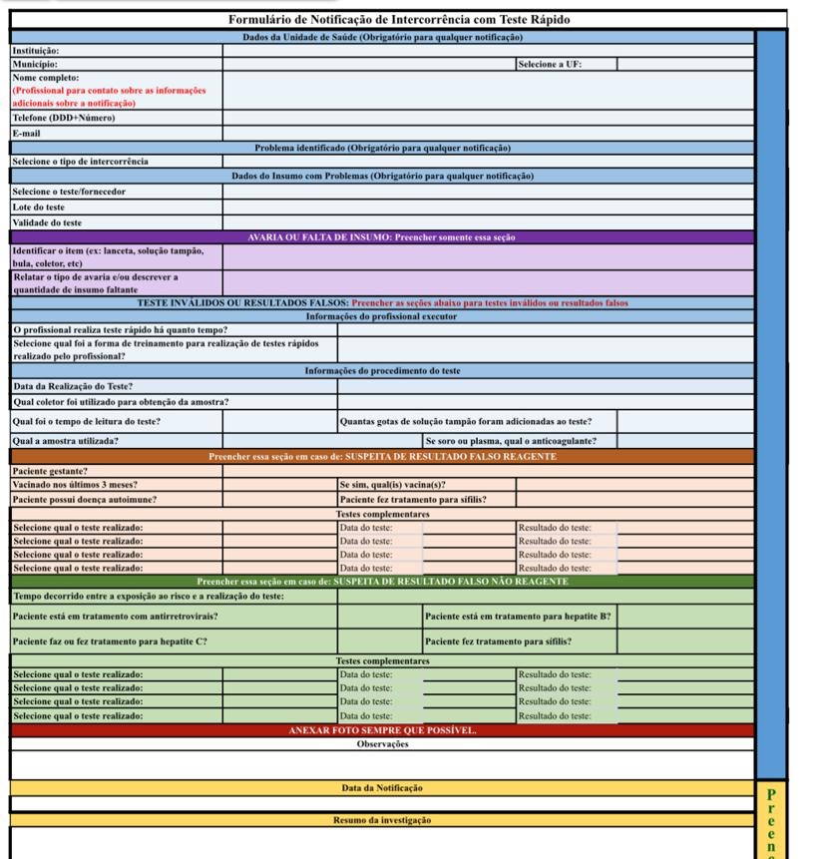
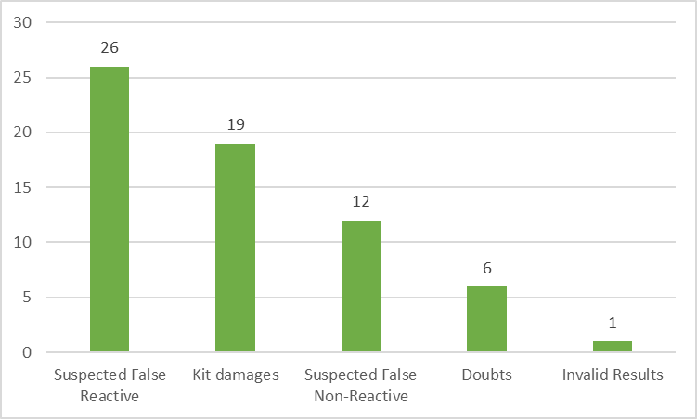
Post-marketing evaluation
Notification
Supplier Evaluation
Discussion between MoH and supplier
Form template to notify the nonconformities for professionals
HIV rapid tests - 2023

Slide 18
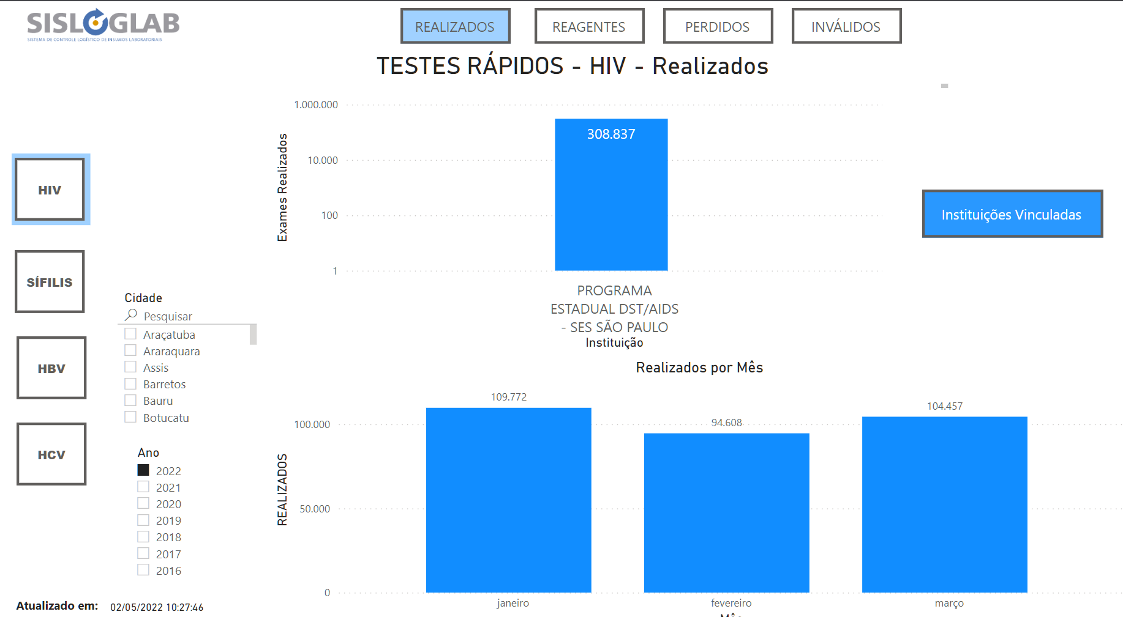
Indicator monitoring - Interactive panel
Performed
Reagents
Missed
Invalids
Municipalities
Institution name
Tests performed per month
Year

Slide 19
SISLOGLAB Guidelines

Slide 20
A test performed without quality is more dangerous to health than a test not performed.

Slide 21
alisson.bigolin@aids.gov.br
diagnostico@aids.gov.br

